Slide 1



Title Layout
Presented to: Dr. Mohamad Aoude
Subtitle
Simulations
Monti Carlo
Done by:
Amar Farshoukh 6300
Zainab Awada 6146

Slide 2

Why Estimate π with Random Points?
Can randomness help us approximate something as precise as π?
The Monte Carlo method is a probabilistic algorithm that uses random sampling to solve problems that might be deterministic in principle.
It’s often used when:
The problem is too complex for exact solutions
The system behaves stochastically (e.g., physics, finance)
We want to approximate a result by observing patterns in randomness
In this project, we used it to approximate π, by simulating millions of random points.
"Chaos can reveal patterns — if we measure it right."

Slide 3

What We Set Out to Do?
🎯 Estimate π using Monte Carlo
🚀 Apply & compare different Parallel Java models
📊 Benchmark and visualize the performance
✅ Ensure statistical correctness and reproducibility

Slide 4
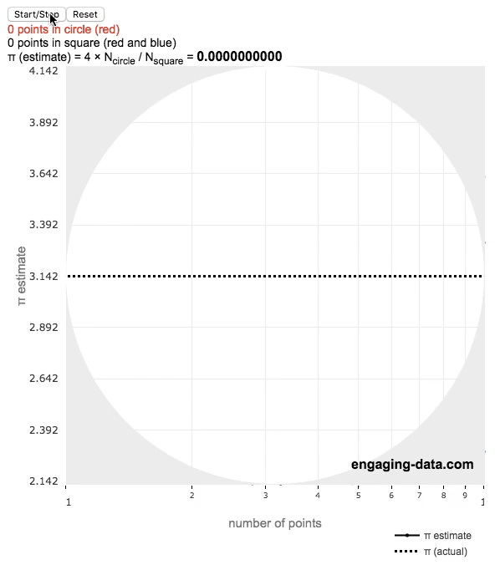
Monte Carlo in Action
Red points (inside circle)​
Red + Blue points (inside square)
π≈4×
Random points are generated inside a unit square.
Each point is tested: • If it falls inside the quarter-circle, it's counted. • The ratio of inside points estimates π/4=(area circle/area square).
The more points we generate, the closer we get to the true value of π.

Slide 5
Architecture Overview
Sequential
Parallel Stream
Each element in the stream is processed concurrently.
Fork/Join Framework
Simple, but slow for large N.
Single thread processes all points one by one.
Minimal code, decent speed-up.
Manual task splitting allows efficient use of CPU cores.
Best performance at large scale.
Loop N times→ generate (x, y)
→ if x² + y² ≤ 1, count++ → π = 4·count/N
IntStream.parallel(N) → each thread: (x, y) & test
→ sum counts → π = 4·total/N
RecursiveTask splits range → subtasks count points → join totals → π = 4·total/N

Slide 6

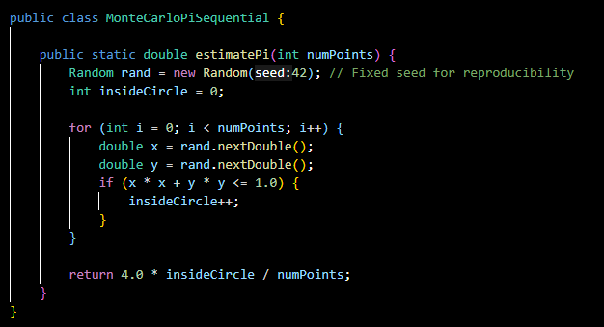
Sequential Code

Slide 7
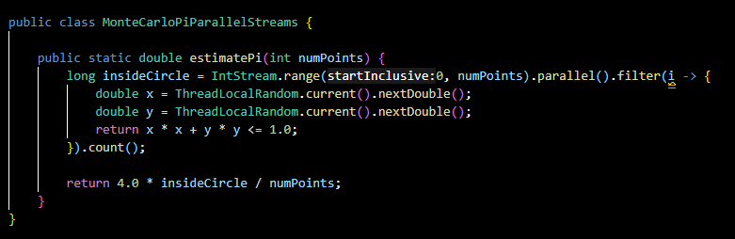
Parallel Stream Code

Slide 8
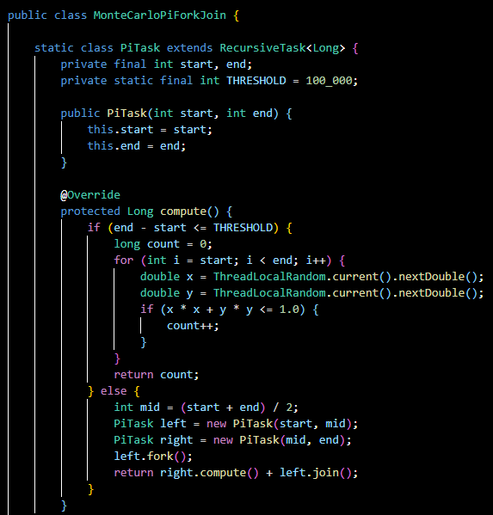
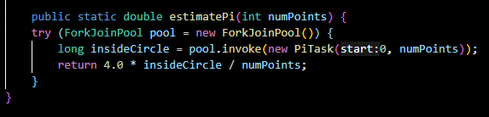
Fork/Join Code
Okay… But!
What about the Results?

Slide 9
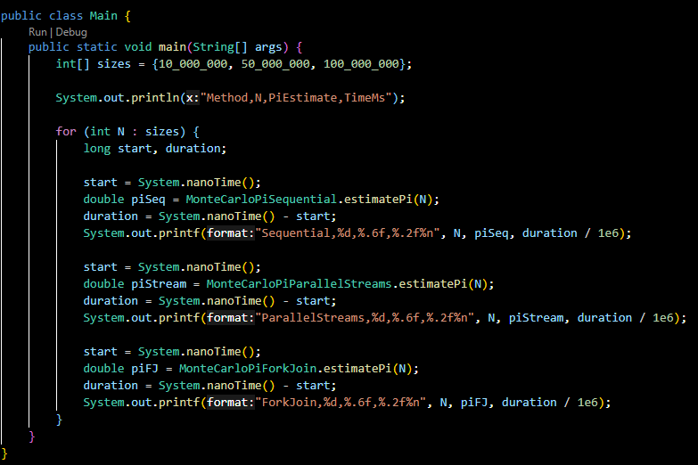
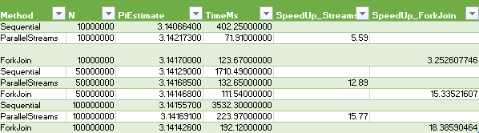
Main Results
Impressive!
So who’s the best method?

Slide 10

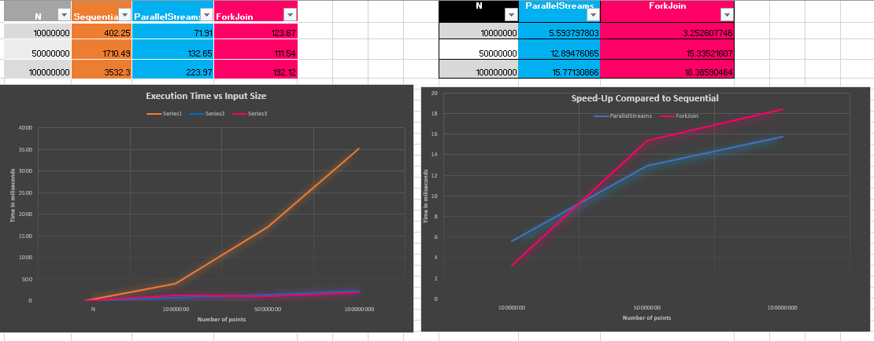
Analysis of Results
For small N (≤10M): Parallel Streams offer a good tradeoff between simplicity and speed.
For large N: Fork/Join provides the best raw performance and scales better.
Sequential is the slowest!

Slide 11
What Did We Learn?
🧠 Performance:
1) Fork/Join is the fastest, especially at scale
2) Streams are ideal for clean and quick parallelism
3) Sequential is reliable but not efficient for large N
🛠 Implementation:
1) Streams: minimal code
2) Fork/Join: best control & scalability
→All versions remain accurate and stable
Conclusion?
"Parallelism doesn’t just make code faster - it makes scale possible."

Slide 12

Thanks For your Attention
Any Questions?

